Slide 1
Data Structures and Algorithms
Lecture 2: Linked Lists
(链表)
Data Science
United International College
Notes:
Start to discuss three of the most simple and basic data structures. Virtually every
significant program will use at least one of these structures explicitly, and a stack is always implicitly used in a program, whether or not you declare one.
List, Stack, Queue
A data structure is a specialized format for organizing and storing data. Any data structure is designed to organize data to suit a specific purpose so that it can be accessed and worked with in appropriate ways. In computer programming, a data structure may be selected or designed to store data for the purpose of working on it with various algorithm.

Slide 2
Outline
Abstract Data Type (ADT) (抽象数据类型)
List ADT
Linked lists

Slide 3
Abstract Data Type (ADT)
Data type = Data + Operation
  Example 1: integer
    Data: a whole number
    Operations: +, - , *, /,…
  Example 2: string
    Data: an array of characters
    Operations: strlen, strcpy, strcat, strcmp,…
Can this be generalized?
  Abstract Data Type (ADT)
  Encapsulation (封装)
Notes:
An abstract data type (ADT ) is a set of data items together with a set of operations. Abstract
data types are mathematical abstractions; nowhere in an ADT ’s definition is there any mention
of how the set of operations is implemented
Abstract - implementation details are not specified

Slide 4
Encapsulation - What
Data
Methods
Users of data
  do not touch (handle) data directly
  operates on data by calling the methods
  do not know how the methods are implemented
Notes:
The interior mechanisms of an implemented ADT should be hidden and inaccessible to the user!
Encapsulation is an important discipline even when the language doesn't fully support it.

Slide 5
Encapsulation - Why
Modular: one module for one ADT
  Implementation of the ADT is separate from its use
  Allows parallel development
  Easier to debug
Code for the ADT can be reused in different applications
Information hiding
  Protect data from unwanted operations
  implementation details can be changed without affecting user programs
Allow rapid prototyping (原型)
  Prototype with simple ADT implementations, then tune them later when necessary
Notes:
A module is a set of methods that work together as a whole to perform some task or set of related tasks.
A module is ‘encapsulated’ if its implementation is completely hidden, and it can be accessed only through a documented interface.
Many ADTs implement generic data structures that can be reused across different projects with few or no modification.

Slide 6
Encapsulation - How
In Object-Oriented Programming (OOP) Languages:
  ADT: Class
  Data: member variables
  Operations: member functions
In C:
  Data: variables (usually of a struct data type)
  Operations: functions
  Information hiding is not explicitly supported in C
Notes:
In C, there is no mechanism for different levels of access control (public, private)
Modular programming in C provides the benefits of information hiding.
declaration and definition and implementations can be included in single source files, not the user source code files
Since the definition of the implementation is not included in the user source code files, they are hidden.

Slide 7
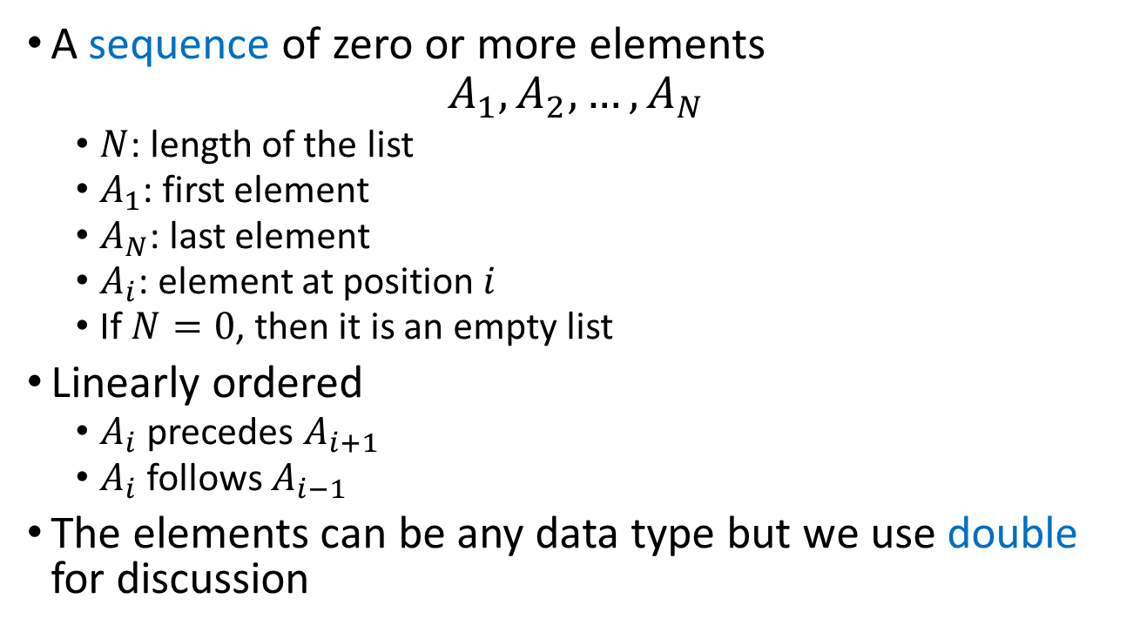
The List ADT - Data
A sequence of zero or more elements
$$A_{1},A_{2},…,A_{N}$$
  $N$: length of the list
  $A_{1}$: first element
  $A_{N}$: last element
  $A_{i}$: element at position $i$
  If $N=0$, then it is an empty list
Linearly ordered
  $A_{i}$ precedes $A_{i+1}$
  $A_{i}$follows $A_{i−1}$
The elements can be any data type but we use double for discussion

Slide 8
The List ADT - Operations
makeEmpty: create an empty list
insert: insert an object to a list (insert after the given position, starts at 1)
  List: 34, 12, 52, 16, 12
  insert(x, 2) -> 34,12,x,52,16,12
remove: delete an element from the list
  List: 34, 12, 52, x, 16, 12
  remove(52) -> 34,12,x,16,12
find: locate the position of the first occurrence of an element in the list
  List: 34, 12, x, 16, 12
  find(12) -> 2
findKth: retrieve the element at a certain position
  List: 34, 12, x, 16, 12
  Find (3) -> x
printList: print the list

Slide 9
Implementation of an ADT
Define data using data types
Define operation using functions
Two standard implementations for the list ADT
  Array-based (基于数组)
  Linked list (链表)

Slide 10
Array Implementation
A₁
A₂
A_{N}
…
List
last
Empty
max_length
Notes:
All these instructions can be implemented just by using an array.
To use an array, an estimate of the maximum size of the list was required
Using dynamic memory allocation for the array initialization

Slide 11
Discussion
Are these operations suitable for the array implementation?
  printList
  find
  insert
  remove
  findKth
Any additional pros and cons?
Notes:
printList – can be carried out in linear time
findKth – can be carried out constant time
Insert or delete depends on where the insertion and deletion occur.
Worst case, insertion into position 0 (at the front of the list), requires to push the entire array down one spot to make room
deleting the first element requires shifting all the elements in the list up one spot, so the worst case is O(N)
Best case, if insert or delete happens at the end of the list, no elements need to be shifted.
Find – depends on the position of the elements, worst case need to visit every element in the list.
There are many situations where the list is built up by insertions at the high end, and then only array accesses (i.e., findKth operations) occur. In such a case, the array is
a suitable implementation. However, if insertions and deletions occur throughout the list and, in particular, at the front of the list, then the array is not a good option.
Pro:
Easy to use and access
Fast access for position-based array access
Cons:
Not efficient for insert, remove and find for not high end positions. Not suitable for data which has high update frequency.
Array has a fixed size of memory, need to estimate the number of elements, resize the array is very inefficient.
All data in the array-based list must be stored sequentially in memory. Large list will require significant continuous block of memory.

Slide 12
Pointer Implementation (Linked List,链表)
Ensure that the list is not stored contiguously
  A node (节点) stores one element
  The address of a node is stored in its previous node
  The address (地址) of the first node must be stored
  The first node is called the head node
  The last node is called the tail node
A1
A2
A_{N}
……
head
Notes:
In order to avoid the linear cost of insertion and deletion, we need to ensure that the list
is not stored contiguously, since otherwise entire parts of the list will need to be moved.
The linked list consists of a series of nodes, which are not necessarily adjacent in
memory. Each node contains the element and a link to a node containing its successor. We
call this the next link. The last cell’s next link points to nullptr.

Slide 13
Discussion
Are these operations suitable for the linked list?
  printList
  find
  findKth
  insert
  remove
Any additional pros and cons?
Notes:
To execute printList() or find(x), we merely start at the first node in the list and
then traverse (遍历) the list by following the next links. This operation is clearly linear-time, as
in the array implementation;
The findKth operation is no longer quite as efficient as an
array implementation; findKth(i) takes O(i) time and works by traversing down the list in
the obvious manner.
remove method can be executed in one next pointer change.
insert method requires obtaining a new node from the system and executing two next pointers maneuvers.
As we can see, in principle, if we know where a change is to be made, inserting or
removing an item from a linked list does not require moving lots of items, and instead
involves only a constant number of changes to node links.
The special case of adding to the front or removing the first item is thus a constant time operation, presuming of course that a link to the front of the linked list is maintained.
The special case of adding at the end (i.e., making the new item the last item) can be constant-time, as long as we maintain a link to the last node.
Removing the last node, we also need to have every node maintain a link to its previous node in the list.
Pros:
linked list can be of any length and it can grow
Elements are not stored contiguous in memory
Nodes can be inserted and deleted in minimal running time
Cons:
1. They use more memory than arrays because of the storage used by their pointers
2. No random access of elements

Slide 14
A Complete list of Comparison
Topic |  | Array | Linked List
Efficiency | insert
 | remove
 | find
 | findKth
space
Notes:
insert/remove – Linked list is better
findKth – Array is better
find – same
Space – Array needs contiguous memory
Linked List – Does not need contiguous memory but use more memory than arrays in order to save the pointer information
Array is preferred when once write many times read.
Linkedlist is preferred when many times of insert/remove is needed.

Slide 15
Linked List Implementation
Data
  Nodes
  A pointer to the first node
typedef struct node{
double data;
struct node* next;
} Node;
Node* head;
Notes:
Notice that we are defining the struct in a recursive manner.
In C, you cannot reference the typedef that you're creating withing the structure itself. You have to use the structure name, as in the following test program
typedef struct node { xxx} Node;
Define a new struct called node
Give this type a new name Node.
Node n is equivalent with struct node n;

Slide 16
Linked List Implementation
Methods
Node *CreatList(int n);
bool IsEmpty(Node* head);
Node* InsertNode(Node* head, int index, double x);
int FindNode(Node* head, double x);
int DeleteNode(Node** phead, double x);
void DisplayList(Node* head);
void DestroyList(Node** head);

Slide 17
Methods
Node *CreatList(int n);
  Create a list of length n
  returns a pointer to the head if the creation is insertion is successful and NULL otherwise
bool IsEmpty(Node* head)
  returns true if the list is empty and false otherwise
Node* InsertNode(Node ** phead, int index, double x)
  insert a new node after position index
  position of nodes starts from 1
  insert a new node as the head if index=0
  returns a pointer to the new node if insertion is successful and NULL otherwise
int FindNode(Node* head, double x)
  returns the position of the first node whose data=x
  returns 0 if no such node exists

Slide 18
Methods (Cont.)
int DeleteNode(Node** phead, double x)
  deletes the first node whose data=x
  returns the position of the deleted node
  returns 0 if no such node exists
void DisplayList(Node* head)
  prints all the nodes in the list
void DestroyList(Node** head)
  deletes all the nodes in the list
  frees the memory allocated to the nodes
  Point the original head to NULL

Slide 19
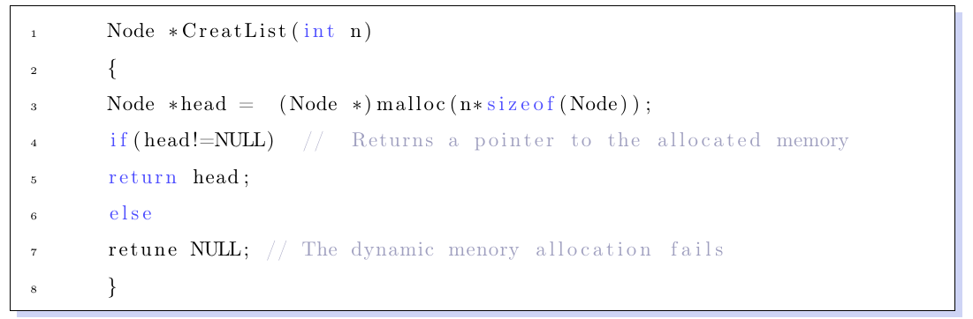

Slide 20
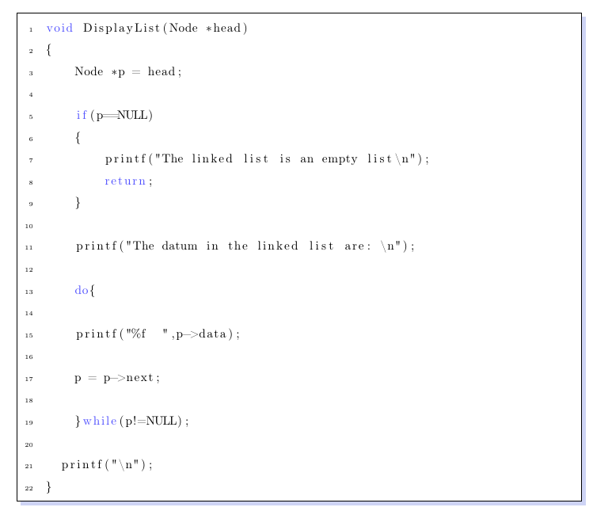

Slide 21
Insert
Node* InsertNode(Node** phead, int index, double x)
  insert a new node after position index
  position of nodes starts from 1
  insert a new node as the head if index=0
  returns a pointer to the new node if insertion is successful and null otherwise
Why Node **phead?
Notes:
Because we need to change the head value to pointing the new node if new node is insert as the first element. The head is not in the return list, have to using &head, to enable the value change inside the InsertNode function.
Node ** phead = & head
Update the head value to pointing to the new inserted head
Ohterwise, we need to change the definition of InsertNode to return the head instead of the new node.

Slide 22
Insert
Locate the element at position index
Allocate memory for the new node
Point the new node to its successor
Point the new node’s predecessor to the new node
InsertNode(&head, 5, 31.6)
A5
A6

Slide 23
Insert
Locate the element at position index
Allocate memory for the new node
Point the new node to its successor
Point the new node’s predecessor to the new node
InsertNode(&head, 5, 31.6)
A5
A7
31.6

Slide 24
Insert
Possible cases of InsertNode
  Insert into an empty list
  Insert in front
  Insert at back
  Insert in middle
But, in fact, only need to handle two cases
  Insert as the first node (Case 1 and Case 2)
  Insert in the middle or at the end of the list (Case 3 and Case 4)

Slide 25
Two Cases for Insert
Insert as the first node
  handles the next pointer of one node
  updates the head pointer
Insert in the middle or at the end
  handles the next pointer of two nodes

Slide 26
Insert as the First Node
InsertNode(&head, 0, 31.6)
A1
head

Slide 27
Insert as the First Node
InsertNode(&head, 0, 31.6)
31.6
A1
head

Slide 28
Code for Insert

Slide 29
#include <stdlib.h>
Node* InsertNode(Node** phead, int index, double x) {
if (index < 0) return 0;
int currIndex = 1;
Node* currNode = *phead;
while (currNode && index > currIndex) {
currNode = currNode->next;
currIndex ++;
}
if (index > 0 && currNode == 0) return 0;
Node* newNode = (Node*)malloc(sizeof(Node));
newNode->data = x;
if (index == 0) {
newNode->next = *phead;
*phead = newNode;
}
else {
newNode->next = currNode->next;
currNode->next = newNode;
}
return newNode;
}

Slide 30
#include <stdlib.h>
Node* InsertNode(Node** phead, int index, double x) {
if (index < 0) return 0;
int currIndex = 1;
Node* currNode = *phead;
while (currNode && index > currIndex) {
currNode = currNode->next;
currIndex ++;
}
if (index > 0 && currNode == 0) return 0;
Node* newNode = (Node*)malloc(sizeof(Node));
newNode->data = x;
if (index == 0) {
newNode->next = *phead;
*phead = newNode;
}
else {
newNode->next = currNode->next;
currNode->next = newNode;
}
return newNode;
}
Try to locate the node at position index. If it does not exist, return null.

Slide 31
#include <stdlib.h>
Node* InsertNode(Node** phead, int index, double x) {
if (index < 0) return 0;
int currIndex = 1;
Node* currNode = *phead;
while (currNode && index > currIndex) {
currNode = currNode->next;
currIndex ++;
}
if (index > 0 && currNode == 0) return 0;
Node* newNode = (Node*)malloc(sizeof(Node));
newNode->data = x;
if (index == 0) {
newNode->next = *phead;
*phead = newNode;
}
else {
newNode->next = currNode->next;
currNode->next = newNode;
}
return newNode;
}
Create a new Node.

Slide 32
#include <stdlib.h>
Node* InsertNode(Node** phead, int index, double x) {
if (index < 0) return 0;
int currIndex = 1;
Node* currNode = *phead;
while (currNode && index > currIndex) {
currNode = currNode->next;
currIndex ++;
}
if (index > 0 && currNode == 0) return 0;
Node* newNode = (Node*)malloc(sizeof(Node));
newNode->data = x;
if (index == 0) {
newNode->next = *phead;
*phead = newNode;
}
else {
newNode->next = currNode->next;
currNode->next = newNode;
}
return newNode;
}
Insert as the new head.

Slide 33
#include <stdlib.h>
Node* InsertNode(Node** phead, int index, double x) {
if (index < 0) return 0;
int currIndex = 1;
Node* currNode = *phead;
while (currNode && index > currIndex) {
currNode = currNode->next;
currIndex ++;
}
if (index > 0 && currNode == 0) return 0;
Node* newNode = (Node*)malloc(sizeof(Node));
newNode->data = x;
if (index == 0) {
newNode->next = *phead;
*phead = newNode;
}
else {
newNode->next = currNode->next;
currNode->next = newNode;
}
return newNode;
}
Insert after currNode.

Slide 34
Find
int FindNode(Node* head, double x)
  returns the position of the first node whose data=x
  returns 0 if no such node exists
Steps
  Search for a node with the value equal to x in the list.
  If such a node is found, return its position. Otherwise, return 0.

Slide 35
Delete
int DeleteNode(Node** phead, double x)
  deletes a node whose data=x
  returns the position of the deleted node
  returns 0 if no such node exists
Steps
  Find the desirable node (similar to FindNode)
  In addition, record the node’s predecessor
  Set the pointers
  Free the memory occupied by the found node

Slide 36
Delete
Deleting a middle or an end node
DeleteNode(&head, 31.6)
A5
A5
31.6
A7
31.6
A7

Slide 37
Delete
Deleting the head
DeleteNode(&head, 2.3)
2.3
A2
head

Slide 38
Destory
void DestroyList(Node** head)
  deletes all the nodes in the list
  frees the memory allocated to the nodes
  Point the original head to NULL
Steps
  Step through the list and delete each node one by one.
  Before deleting a node, obtain its next node.

